Slide 1

KPI Dashboard & Security Metrics

Slide 2
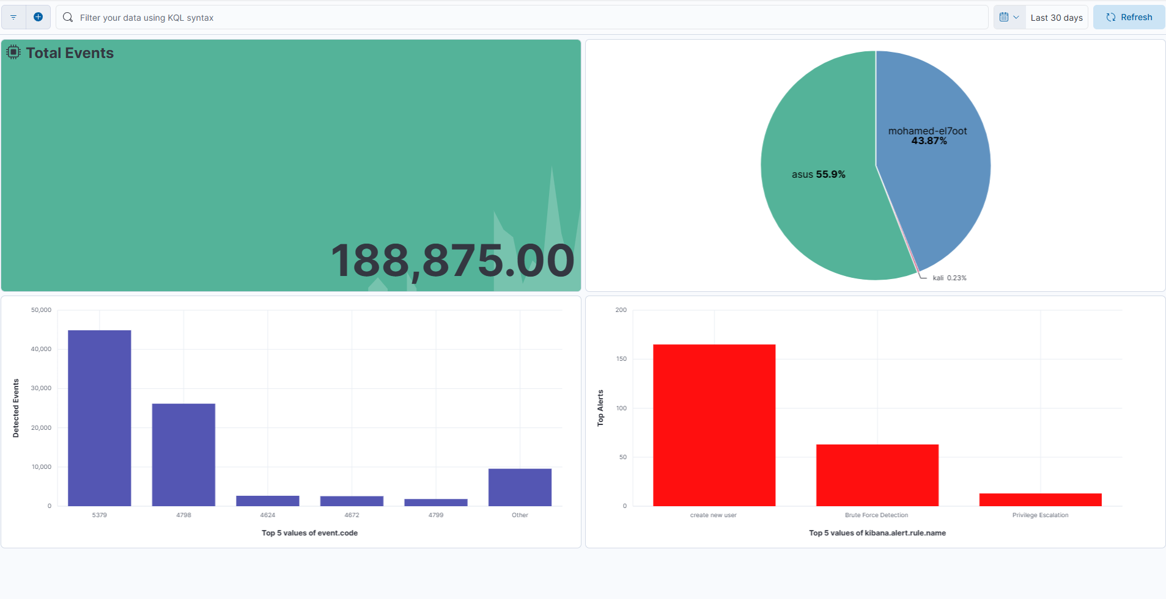
Mini SOC Security Dashboard

Slide 3

Total Events
Counts all system events

Slide 4
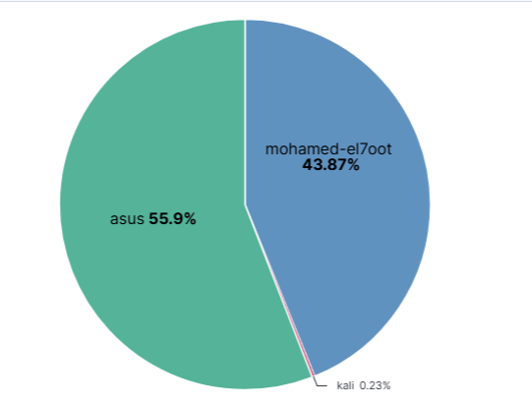
Hosts Distribution
Display system-monitored endpoints distribution

Slide 5
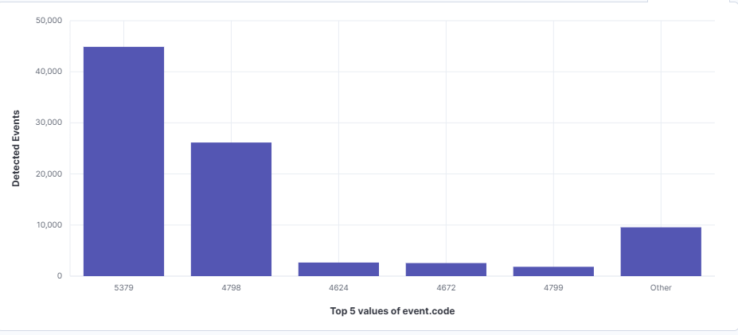
Detected Events
Display system events

Slide 6
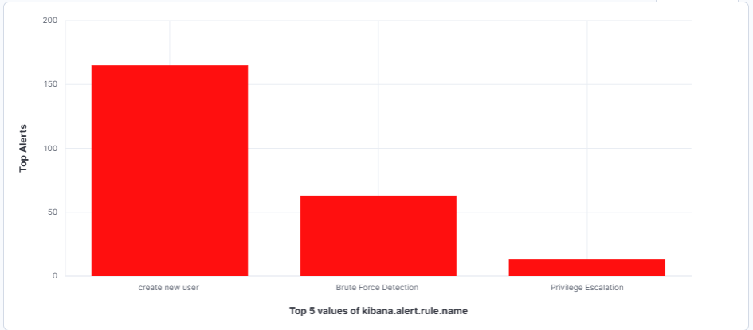
Top Alerts
Display Alerts if there is an attack

Slide 7
Perform root cause analysis for a selected incident
Root Cause Analysis
Incident
Brute Force Attack
Detection
Event ID 4625
Multiple Failed Login Attempts
Weak password policy and repeated authentication attempts allowed the attacker to perform password guessing attacks.
Root Cause
Impact
Potential unauthorized access to user accounts.
- Enable MFA.
- Implement account lockout policies.
- Use strong passwords.
- Monitor Event ID 4625.
Recommendations

Slide 8
From the Dashboards section, a new dashboard was created and customized with multiple visualizations to present security KPIs, event statistics, and monitored endpoints. The dashboard serves as a centralized monitoring interface for the SOC team, enabling analysts to quickly detect anomalies, track security incidents, analyze attack patterns, and make informed decisions during incident response activities.

